Slide 1
An Energy-efficient Deep Belief Network Processor Based on Heterogeneous Multi-core Architecture with Transposable Memory and On-chip Learning
Jiajun Wu, Xuan Huang, Le Yang, Jipeng Wang, Ziyuan Wen, Juhui Li, Guoyi Yu, Kwen-Siong Chong and Chao Wang

Slide 2
Outline
Introduction
Algorithm-level Analysis of Deep Belief Network
Proposed Architecture and Circuit Design
Evaluation and Discussion
Conclusion

Slide 3

Introduction
In some energy-limited applications such as edge computing, existing power-hungry AI platforms like Graph Processing Unit (GPU) face challenges due to large power consumption of DNN processing.
Why on-chip learning?
Intelligent IoT edge devices
Various DNN on-chip learning accelerators have been proposed for edge devices
it is urgently required to implement DNN models with light computation and realize local storing of DNN parameters to reduce accesses of off-chip memory
Off-chip data movement is 2-3 orders of magnitude more expensive in energy consumption compared to on-chip data movement.
Reduce latency.
Minimize power.
Ensure security.
Protect privacy.
It is a trend for AI accelerator
Notes:
这页照着文字就行

Slide 4

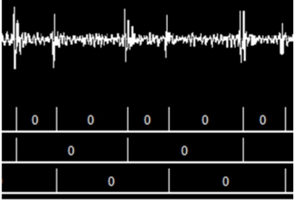
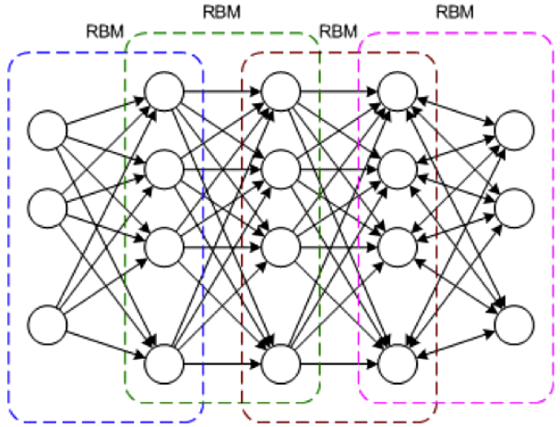
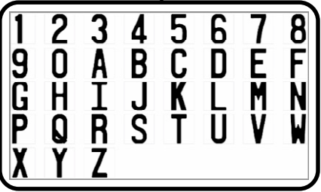

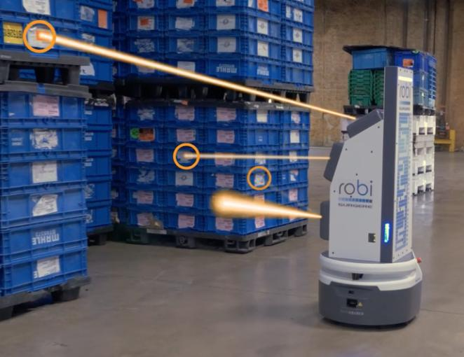
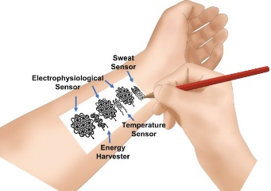
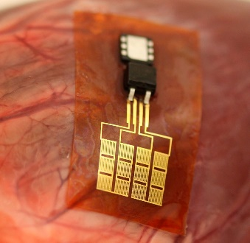
Introduction
Deep Belief Network (DBN)
ECG
Results
Input
Robots
Binary activations
Unsupervised learning dominates
Local update of weights
Wearable devices
Notes:
本工作基于一种特殊的DNN模型——深度信念网络DBN，设计高能效的片上学习处理器
DBN的特点（图下方三点）
右边是DBN的应用场景

Slide 5
Introduction
We analyzed the training dataflow and observed an interesting feature that local weights can be perfectly reused during different local learning phases
Algorithm Level - Data Reuse of Local Weights
Algorithm-hardware-circuit co-exploration
A transposable multi-core architecture is proposed for highly parallel computation and local data movement.
Architecture Level – Transposable Multi-core Architecture
An energy-efficient transposable memory is proposed to support transposable reading and skip MAC operations due to zero activations
Circuit Level - Transposable Local Memory and Skip Reading
Notes:
本工作的贡献：从算法分析出发，挖掘DBN模型中的数据稀疏性与数据复用特性，指导架构-电路层次的协同设计
在架构层次，本工作提出了一种异构多核架构，适合DBN的片上学习数据流
在电路层次，本工作提出了转置存储器和稀疏地址生成器电路，支持权重的转置读取与零值的跳读

Slide 6
Algorithm-level Analysis of Deep Belief Network
RBM Model
The learning process of DBN is divided into unsupervised learning of several Restricted Boltzmann Machine (RBM).
RBM is a probabilistic model serves as encoder-decoder
DBN Model
Jiajun Wu et al., “An Energy-efficient Deep Belief Network Processor Based on Heterogeneous Multi-core Architecture with Transposable Memory and On-chip Learning,” IEEE Journal on Emerging and Selected Topics in Circuits and Systems, 2021, under review.
Notes:
DBN是全连接模型，片上无监督学习可分割为多个受限玻尔兹曼机（RBM）各自的无监督学习
RBM由DBN中相邻的两层组成

Slide 7

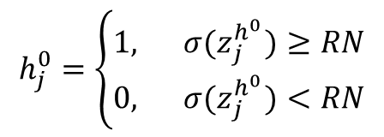

Algorithm-level Analysis of Deep Belief Network
Two Forward Generation (FG) and one Backward Reconstruction (BR) phases before updating weights.
Weighted Sum and Gibbs Sampling are processed under each phase.
For instance,
$$h_{j}^{0}=\left\{\begin{aligned}1,{ σ(z}_{j}^{h^{0}})≥RN \\ 0,{ σ(z}_{j}^{h^{0}})<RN\end{aligned}\right.$$
$$z_{j}^{h^{0}}= \sum_{i=1}^{n}{v_{i}^{0}×w_{i,j}}$$
Multiply-Accumulation, MAC
Gibbs Sampling
RBM Unsupervised Learning – CD Algorithm
Update,
$$∆W=δ(V^{0}H^{0}−V^{1}H^{1})$$
Local!
Jiajun Wu et al., “An Energy-efficient Multi-core Restricted Boltzmann Machine Processor with On-chip Bio-plausible Learning and Reconfigurable Sparsity,” in 2020 IEEE Asian Solid-State Circuits Conference (A-SSCC), 2020.
Notes:
强调加权求和、吉布斯采样、局部学习
加权求和 吉布斯采样采用异构架构，不同的处理单元来完成
局部学习算法，使权重可以被映射在局部存储中，减少数据传输能耗

Slide 8

Algorithm-level Analysis of Deep Belief Network
$$z_{1}^{h^{0}}= \sum_{j=1}^{n}{v_{j}^{0}×w_{1,j}}=\sum_{j=1}^{p}{v_{j}^{0}×w_{1,j}}+\sum_{j=p+1}^{p+q}{v_{j}^{0}×w_{1,j}}+…+v_{n}^{0}×w_{m,n}$$
Parallel
Sub-network
Sparsity
$$v_{j}^{0}×w_{1,j}$$
If $v_{j}^{0}=0$, this multiplication will not contribute to results
Sub-network & Reuse weights
Sparsity of neuron states
Jiajun Wu et al., “An Energy-efficient Deep Belief Network Processor Based on Heterogeneous Multi-core Architecture with Transposable Memory and On-chip Learning,” IEEE Journal on Emerging and Selected Topics in Circuits and Systems, 2021, under review.
Notes:
并行加速->子网络->局部权重的转置复用
稀疏性 强调跳过operation和跳过reading

Slide 9
Proposed Architecture and Circuit Design
Architecture Design
MPSE is for MAC operations of each sub-network.
ASE is for accumulating partial sums of sub-networks, and sampling new states by Gibbs Sampling.
Local weights and local learning.
Limit the data transition into local bus, reducing communication costs.
Proposed Heterogeneous Multi-core Architecture
Jiajun Wu et al., “An Energy-efficient Deep Belief Network Processor Based on Heterogeneous Multi-core Architecture with Transposable Memory and On-chip Learning,” IEEE Journal on Emerging and Selected Topics in Circuits and Systems, 2021, under review.
Notes:
按照右边的四句话展开即可

Slide 10
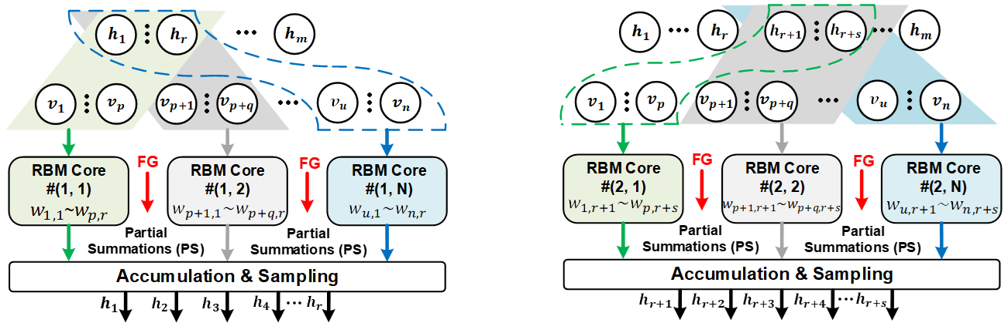
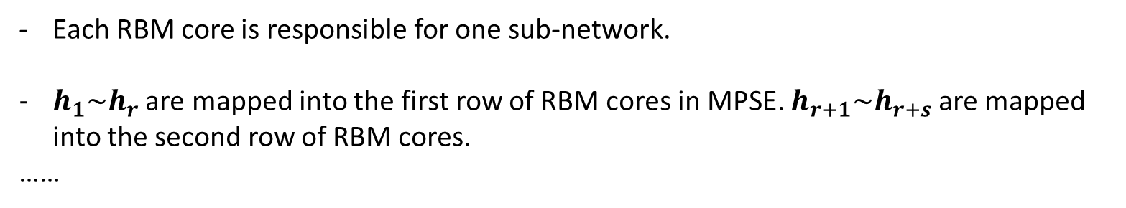
Proposed Architecture and Circuit Design
Data Mapping
Each RBM core is responsible for one sub-network.
$h_{1}\sim h_{r}$ are mapped into the first row of RBM cores in MPSE. $h_{r+1}\sim h_{r+s}$ are mapped into the second row of RBM cores.
……
Notes:
同一行RBM core负责计算相同的hidden neurons
同一列RBM core负责计算相同的visible neurons

Slide 11
Proposed Architecture and Circuit Design
Circuit Design
How to efficiently compute MACs in one sub-network?
Utilize the transposed reuse of local weights -> Transposable Memory to improve energy efficiency
Notes:
根据算法层次的分析，权重将在每个RBM core里转置复用
传统的方案无法在反向生成阶段（BR）并行读取
我们提出了转置存储的方案，减少了权重转置操作带来的能耗开销

Slide 12
Proposed Architecture and Circuit Design
Circuit Design
Compared with conventional SRAM, we added a new set of address lines and data lines
Register-based memory
Proposed Transposable Memory
Jiajun Wu et al., “An Energy-efficient Multi-core Restricted Boltzmann Machine Processor with On-chip Bio-plausible Learning and Reconfigurable Sparsity,” in 2020 IEEE Asian Solid-State Circuits Conference (A-SSCC), 2020.
Notes:
基于寄存器实现，未来将探索asic实现的方案
强调已被ASSCC接收

Slide 13
Proposed Architecture and Circuit Design
Circuit Design
Sparse Address Generator
Skip Zero
The skipping zero method reduces energy consumption of invalid reading and computations
The sparse addresses are generated BEFORE FG and BR phases
Jiajun Wu et al., “An Energy-efficient Multi-core Restricted Boltzmann Machine Processor with On-chip Bio-plausible Learning and Reconfigurable Sparsity,” in 2020 IEEE Asian Solid-State Circuits Conference (A-SSCC), 2020.
Notes:
强调跳读
在右图的RBM示意图中，假设$v_{2}$为0，那么在预生成地址阶段，不会生成“2”这个地址，由此，在MAC运算中，所有并行PE都不会取出这些权重（$w_{2,1}, w_{2,2}, w_{2,3}, ... , w_{2,r}$）

Slide 14
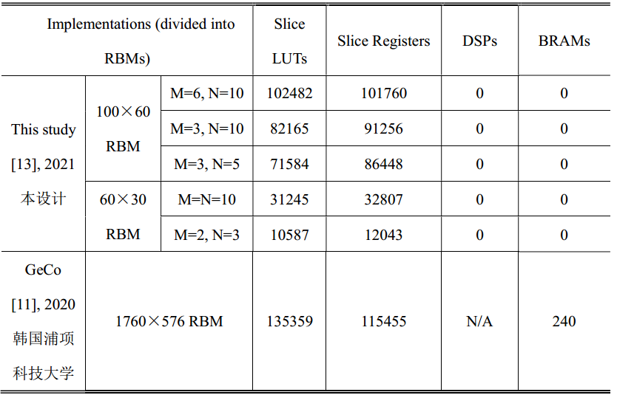
Evaluation and Discussion
Performance – Hardware Cost
Resource Cost
Hardware overhead divided into different components for LUT and FF
Jiajun Wu et al., “An Energy-efficient Deep Belief Network Processor Based on Heterogeneous Multi-core Architecture with Transposable Memory and On-chip Learning,” IEEE Journal on Emerging and Selected Topics in Circuits and Systems, 2021, under review.
Notes:
由于转置权重存储器无法在被综合为Block RAM（BRAM），导致LUT和register这两个资源的大量开销
从图中可以看出，转置权重存储器占用了大部分硬件开销，在LUT中占48.0％，在寄存器中占64.6％
强调未来做ASIC，因为FPGA实现会占用很多资源

Slide 15
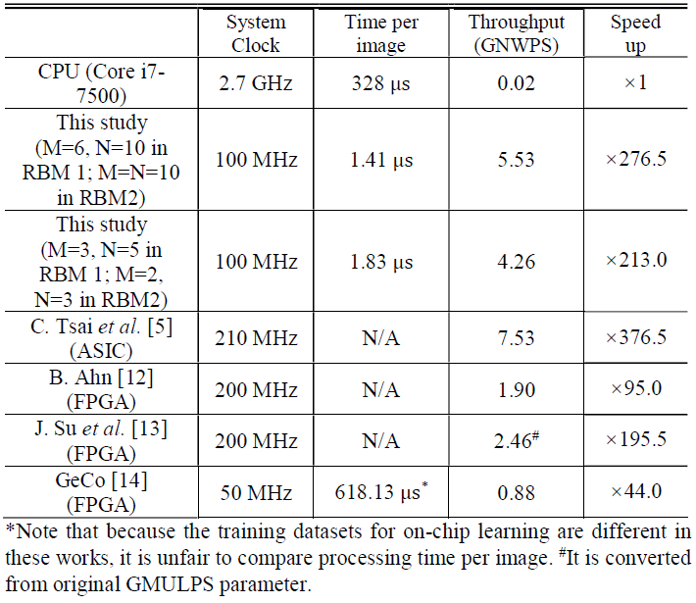
Evaluation and Discussion
Performance - Throughput
GNWPS：G Neural Weights Per Second
×2.25 faster than the state-of-art FPGA work
The architecture with more RBM cores has higher throughput
We can also use “FLOPS/s” to evaluate the throughput. But it does not suit this case.
Jiajun Wu et al., “An Energy-efficient Deep Belief Network Processor Based on Heterogeneous Multi-core Architecture with Transposable Memory and On-chip Learning,” IEEE Journal on Emerging and Selected Topics in Circuits and Systems, 2021, under review.
Notes:
根据右边的展示，带过即可

Slide 16
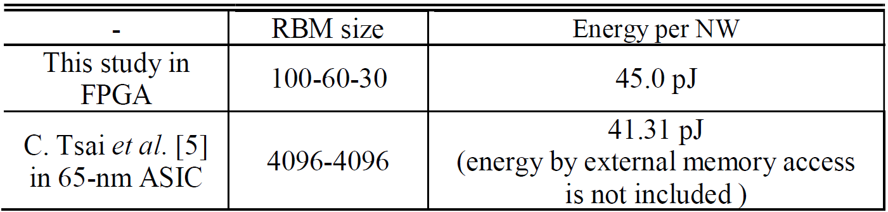
Evaluation and Discussion
Performance - Energy Efficiency
Evaluate energy efficiency: energy per Neural Weights update
Improve 74% energy efficiency due to sparse address generator
Energy efficiency improvement due to data sparsity optimization
Notes:
强调能效提升74%，在稀疏性优化的帮助下

Slide 17
Conclusion
This paper presents an energy-efficient DBN processor based on heterogeneous multi-core architecture with transposable weight memory and on-chip local learning.
In architecture level, a heterogeneous multi-core architecture with on-chip local learning is proposed based on algorithm-level analysis. Besides, in order to improve the efficiency of the architecture, this study proposes a transposable memory design and a pre-generated address circuit at the circuit level, so that each core can utilize the weight reuse and data sparsity for efficient operations.
In the future, we will focus on ASIC implementation of the proposed DBN processor to optimize the bottlenecks and further improve throughput and energy efficiency.

